Slide 1
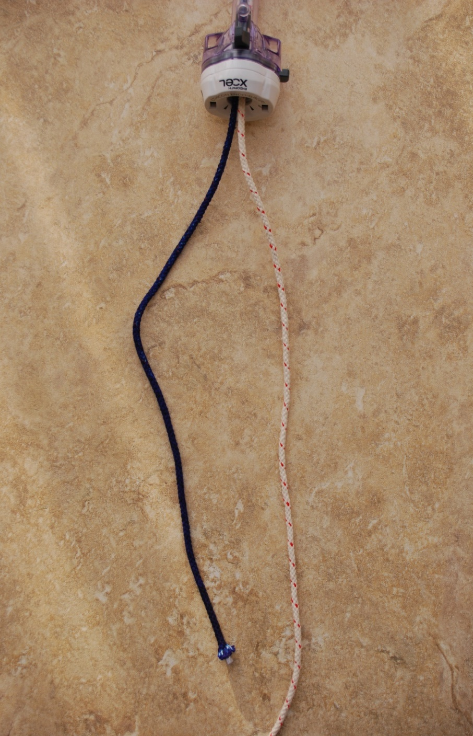
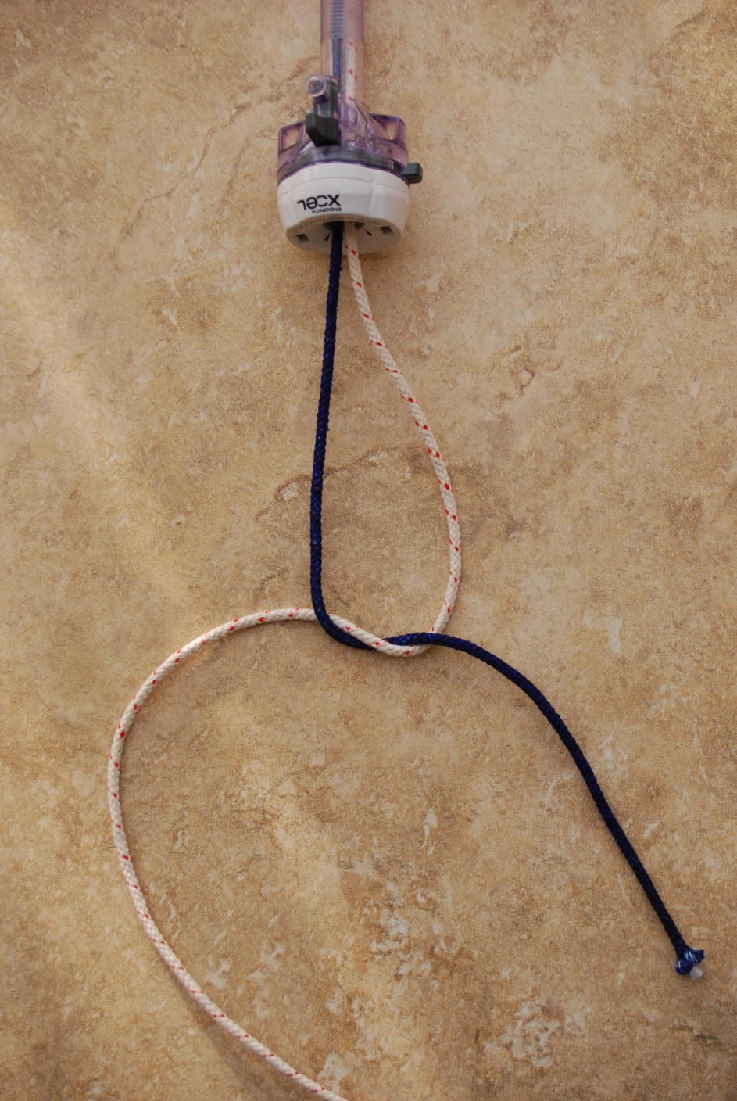

Slide 2
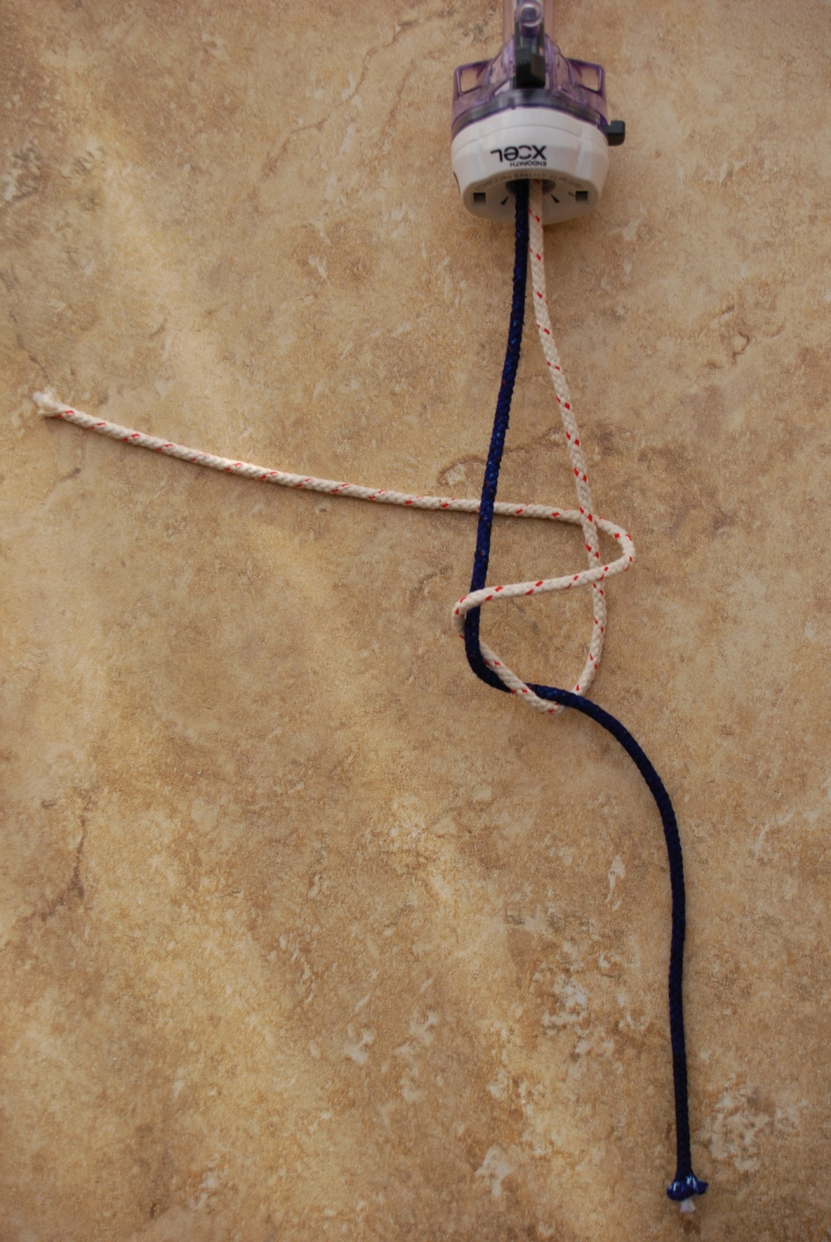
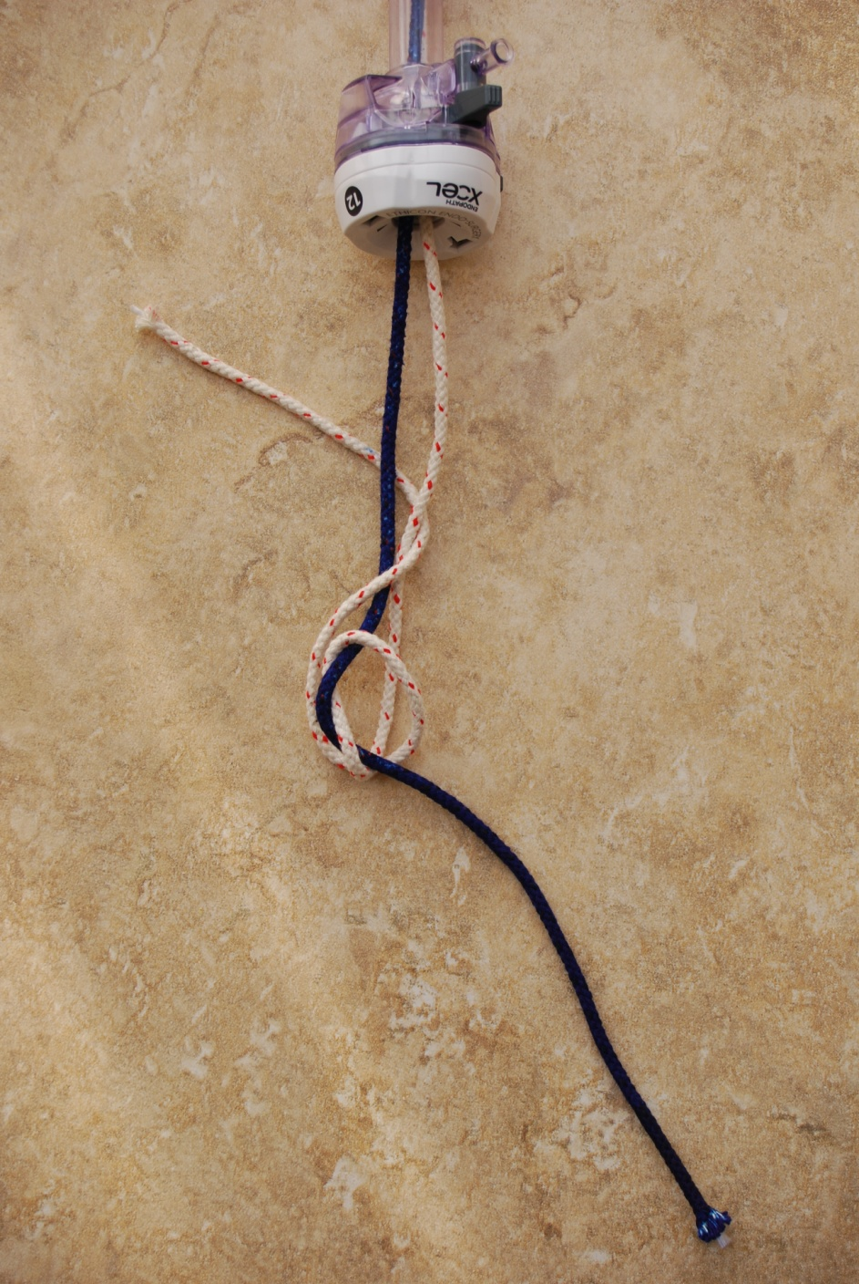

Slide 3
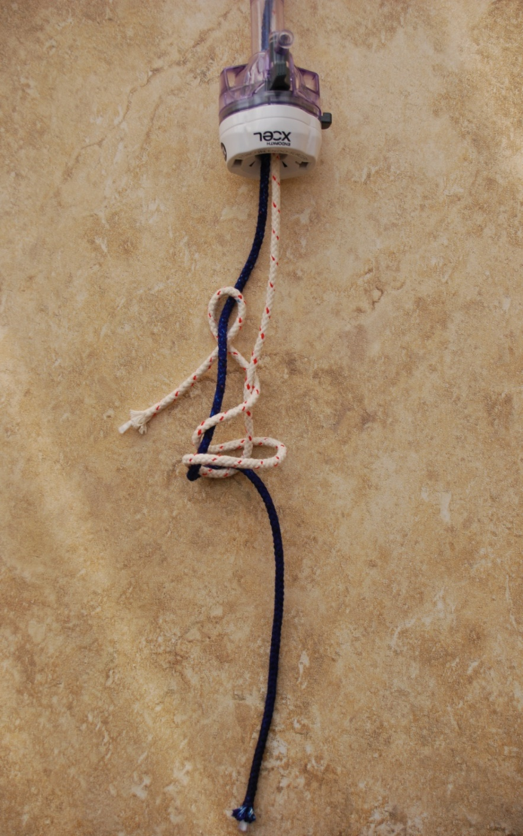
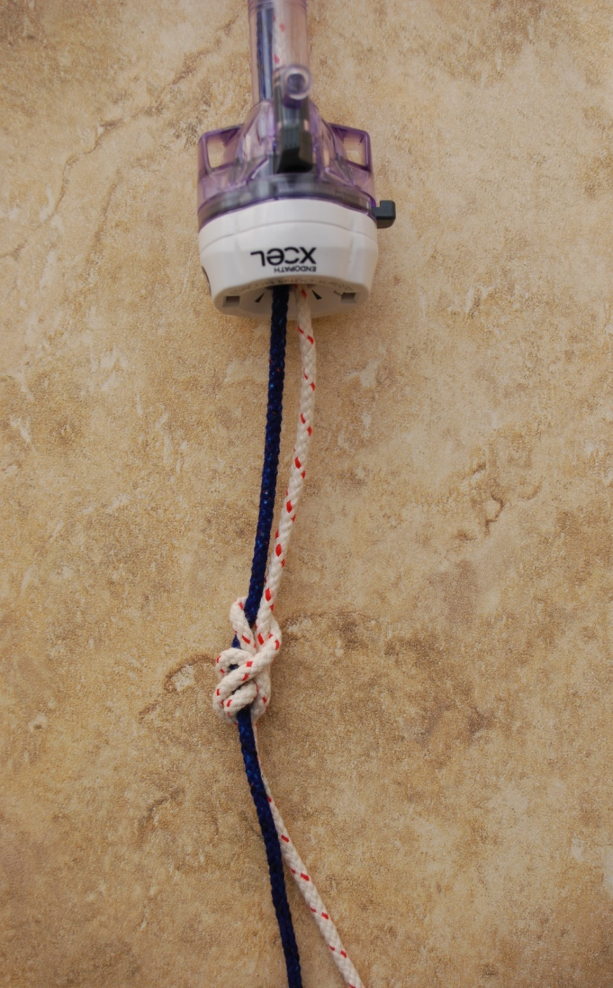

Slide 4
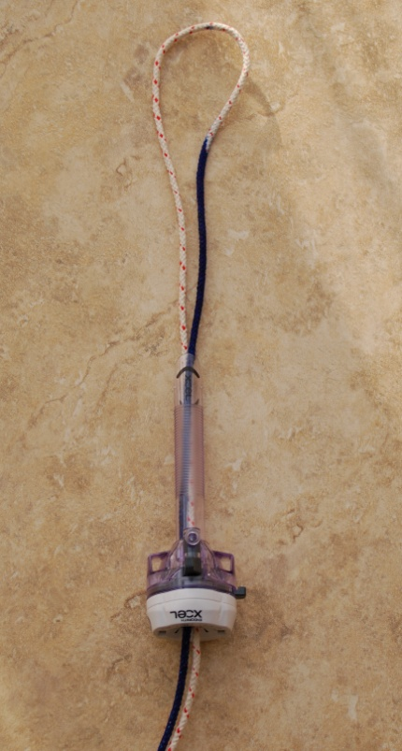
Stage 1
Loop the tie around the structure to be ligated and bring out the end through the same port
Choose one end to be the static end (in this instance the left sided thread coloured blue for ease).
This is the STANDING END (blue). IF THERE IS A NEEDLE THE NEEDLE END MUST BE THE STANDING END
The other end then is to become the knot which will slide along the static (srtanding) limb.
This is the ACTIVE END (white / red)

Slide 5
Stage 2
Throw a half knot as demonstrated

Slide 6
Stage 3
Continue with the Active end and complete a full turn around both threads

Slide 7
Stage 4
Continue around once more finishing with the Active end next to the Standing thread

Slide 8
Stage 5
Use the Active end to throw a jamming half hitch around the Standing end.
The effect of this is so that as the knot is tightened on the tissues the half hitch will automatically tighten and the knot will be secure

Slide 9
Stage 6
The knot may be tightened.
The line of the Standing end is seen to be straight and the knot will now slide along this onto the tissues as a one way slipping knot.
Cut the excess thread and slide the knot onto the tissues by whatever means appropriate

